Slide 1
How to use sign language!
By Holly Smith, Katie smith and Megan Bowe

Slide 2
How do you learn and use sign language?
Sign language is used to communicate with deaf people.
Sign language is using hand gestures to speak.
In the UK there is 15.6 million people who have hearing loss, 45,000 are children.
There are people all over the UK that can teach you sign language. Megan and Ellie taught the children at cubs-an adventure club- how to spell their names using sign language.

Slide 3
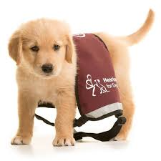
FACTS!!!!!!!!!!!!!!!!
British sign language is usually referred to as BSL.
You can get hearing dogs.
You have to go through allot of training to get a hearing dog.

Slide 4
We will now teach you the alphabet

Slide 5
A

Slide 6
B

Slide 7
C

Slide 8
D

Slide 9
E

Slide 10
F

Slide 11
G

Slide 12
H

Slide 13
I

Slide 14
J

Slide 15
K

Slide 16
L

Slide 17
M

Slide 18
N

Slide 19
O

Slide 20
P

Slide 21
Q

Slide 22
R

Slide 23
S

Slide 24
T

Slide 25
U

Slide 26
V

Slide 27
W

Slide 28
X

Slide 29
Y

Slide 30
Z

Slide 31
We now need a volunteer from each year group

Slide 32
Hello in sign language

Slide 33
QUIZ!!!

Slide 34
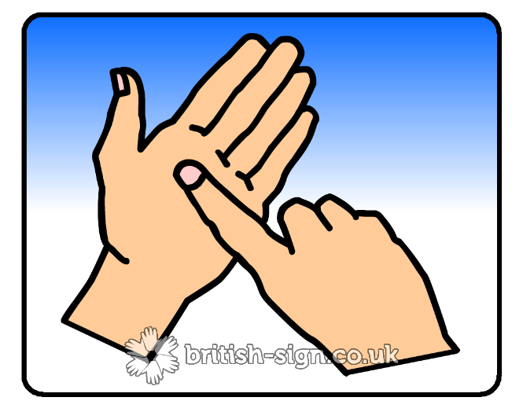
What is G in sign language?

Slide 35
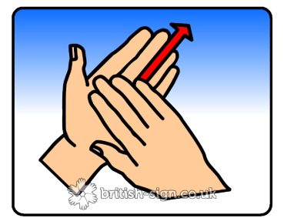
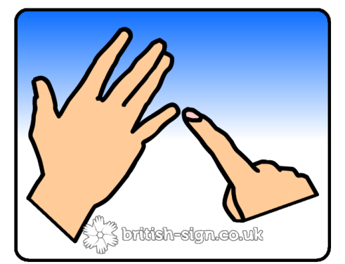
What is H in sign language?

Slide 36
What is m in sign language?

Slide 37
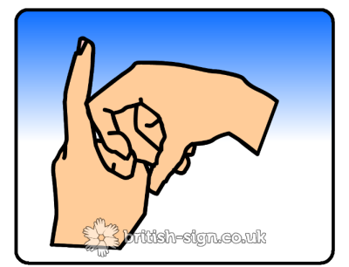
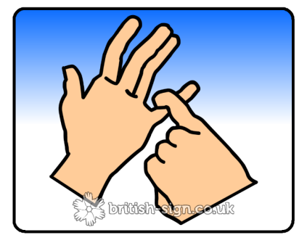
What is K in sign language?

Slide 38
What is s in sign language?

Slide 39
NO!!!!!!!!!!!!!!!!!!!!!!!!!!!!!!!!!!!!!!!!!!!!!!!!!!!!!!!!!!!!!!!!!!!!!!!!!!!!!!!!!!!
☹ ☹ ☹ ☹ ☹ ☹ ☹ ☹ ☹
!!!!!!!!!!!!!!!!!!!!!!!!!!!!!!!!!!!!!!!!!!!!!!!!!!!!!!!!!!!!!!!!!!!!!!!!!!!!!!!!!!!!!!!!!!!!!!!

Slide 40
YES!!!!!!!!!!!!!!!!!!!!!!!!!!!!!!!!!!!!!!!!!!!!!!!!!!!!!!!!!!!!!!!!!!

Slide 42
This will be on the back of your Friday Letter!

Slide 43
Design Time!!!!!!!!!!!!!
Instead of (or as well as) you can design a poster about what you have learned today.

Slide 44
Example!

Slide 45
BYE and thanks for listening!!!!!!!!!!!!!!!!!! ☺☺☺☺☺☺☺☺☺☺

